Slide 1

VIDEO STREAMING MANAGEMENT
Project Supervisor:
Mrs. ASHA JUDI.V M.E.
Name of the Student: PASHAM VYSHNAVI
Register Number:40111456

Slide 2

Presentation Outline
Introduction
Objectives
System Architecture
Methodology
Application Snapshots
Conclusion
References

Slide 3

Introduction
Video streaming management refers to the process of managing and maintaining a platform for delivering video content over the internet. With the widespread availability of high-speed internet, video streaming has become a popular method of delivering content to audiences around the world. Online video streaming platforms provide an opportunity for individuals and organizations to share their content with a global audience, including live events, webinars, movies, and television shows.
The management of an online video streaming platform involves several aspects, including content creation, technical management, user experience management, analytics, and revenue generation. The platform must be designed to provide an enjoyable viewing experience to the audience, including ensuring high-quality video and audio playback, easy navigation, and effective search and recommendation systems.

Slide 4
Introduction
Effective video streaming management requires a robust technical infrastructure, including servers, content delivery networks, and security measures to ensure the platform is reliable and secure. Managing the user experience involves optimizing the platform's design to enhance engagement and user retention, including implementing social sharing, chat features, and community management.
Analyzing user behavior and data is essential to identify trends and make informed decisions to optimize content, improve user experience, and increase revenue. Revenue generation can involve various strategies, including advertising, subscription-based services, and pay-per-view models.
Overall, effective video streaming management requires a combination of technical expertise, creativity, and business acumen to create an engaging and sustainable platform that meets the needs of both the audience and the content creators.

Slide 5
Objective
Online video streaming management can vary depending on the specific goals of the organization or individual managing the platform. However, some general objectives may include:
Providing high-quality video content: The primary objective of online video streaming management is to provide high-quality video content to the audience. This includes ensuring that the videos are clear, have good sound quality, and are accessible to users with different internet speeds.
Managing the platform: The management of the platform includes maintaining the servers, ensuring that the platform is secure, and managing the user experience. This can involve addressing any technical issues that arise and providing support to users.
Increasing audience engagement: The goal of online video streaming is to engage the audience and encourage them to interact with the platform. This can involve developing strategies to increase engagement, such as creating interactive content or encouraging users to share their experiences on social media.

Slide 6
Objective
Generating revenue: Many organizations use online video streaming as a way to generate revenue. This can involve selling advertising space, charging users for access to premium content, or creating sponsorship opportunities.
Analytics: Analyzing user behavior and data is essential to identify trends and make informed decisions. Understanding the metrics can help organizations optimize content, improve user experience, and increase revenue.
Overall, the objectives of online video streaming management will depend on the specific needs and goals of the organization or individual managing the platform.

Slide 7
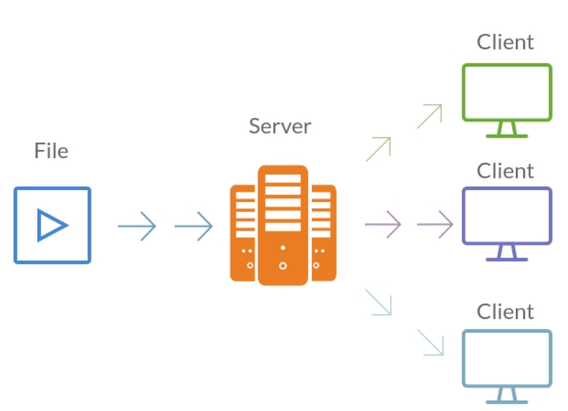
System Architecture

Slide 8

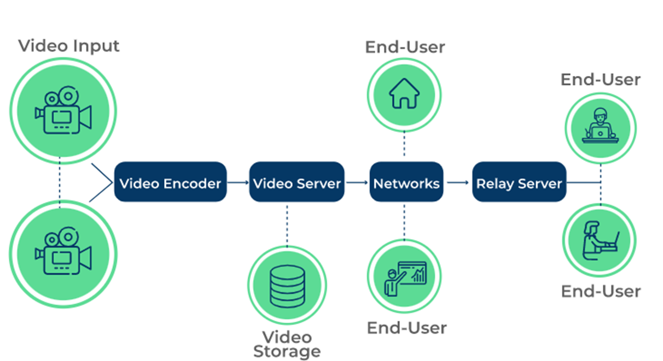
System Architecture

Slide 9
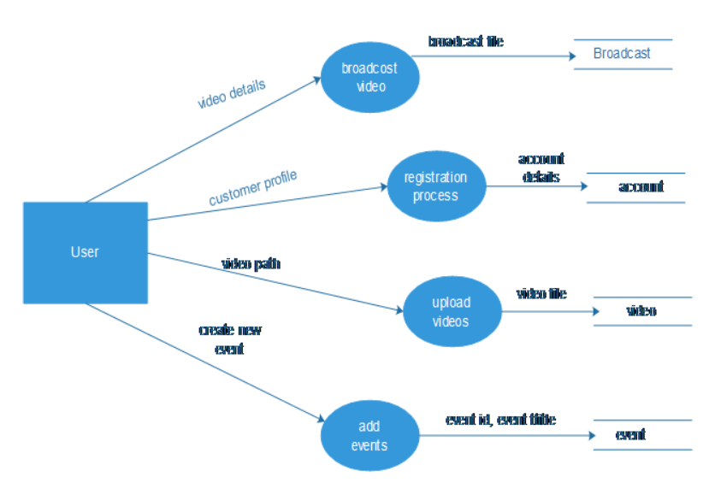
System Architecture

Slide 10
Project Implementation
The implementation of online video streaming management for different types of content requires specific considerations. Here are some aspects to consider for implementing video streaming management for PDFs, gaming, apps, and children's content:
PDFs: Video streaming management for PDFs involves converting PDFs into a video format for streaming. This can include creating voiceovers, animations, or videos that explain the content. PDF streaming management also requires optimizing the video for mobile devices, ensuring high-quality audio, and enabling easy navigation.
Gaming: Video streaming management for gaming requires a focus on the user experience, including high-quality video and audio playback, low latency, and minimal lag. It also requires implementing game-specific features, such as the ability to switch between gameplay and commentary, multiple camera angles, and chat features.

Slide 11
Project Implementation
3.Apps: Video streaming management for apps involves creating videos that showcase the app's features and benefits, including step-by-step tutorials, demonstrations, and testimonials. App streaming management also requires optimizing videos for mobile devices, providing high-quality audio, and enabling easy navigation.
4.Children's content: Video streaming management for children's content requires implementing child-friendly features, including parental controls, content filtering, and age-appropriate recommendations. It also requires creating videos that engage children, including animations, songs, and interactive features.
In all cases, video streaming management requires a robust technical infrastructure, including servers, content delivery networks, and security measures to ensure the platform is reliable and secure. It also requires a focus on analytics to identify trends and make informed decisions to optimize content, improve user experience, and increase revenue.

Slide 12
Methodology and Algorithm
You will need xampp installed on your computer.
Run the XAMPP control panel and start MySQL and Apache
You will need an account on Firebase and you should create a project on your firebase account dedicated to this streaming project.
You will need the movie file (which I added in this repo) to seed your firebase backend with movies information. OR you can use your seed file with your information if you want.
Open the browser and go to http://localhost/phpmyadmin/ to create the database
Click the new to create a database.
Name the database sourcecodester_ omsdb.
Click import to import the sql file.

Slide 13
Methodology and Algorithm
Open the browser and go to http://localhost/onlinemovies/
Accessing admin accounts
Username: admin@gmail.com Password: admin

Slide 14
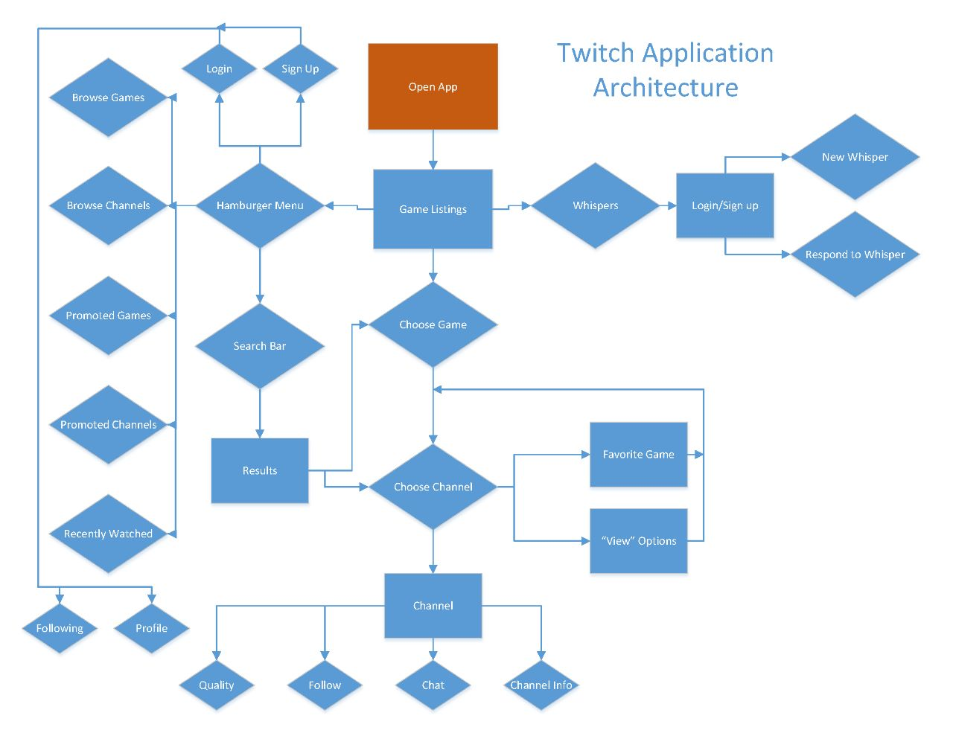
Methodology and Algorithm

Slide 15
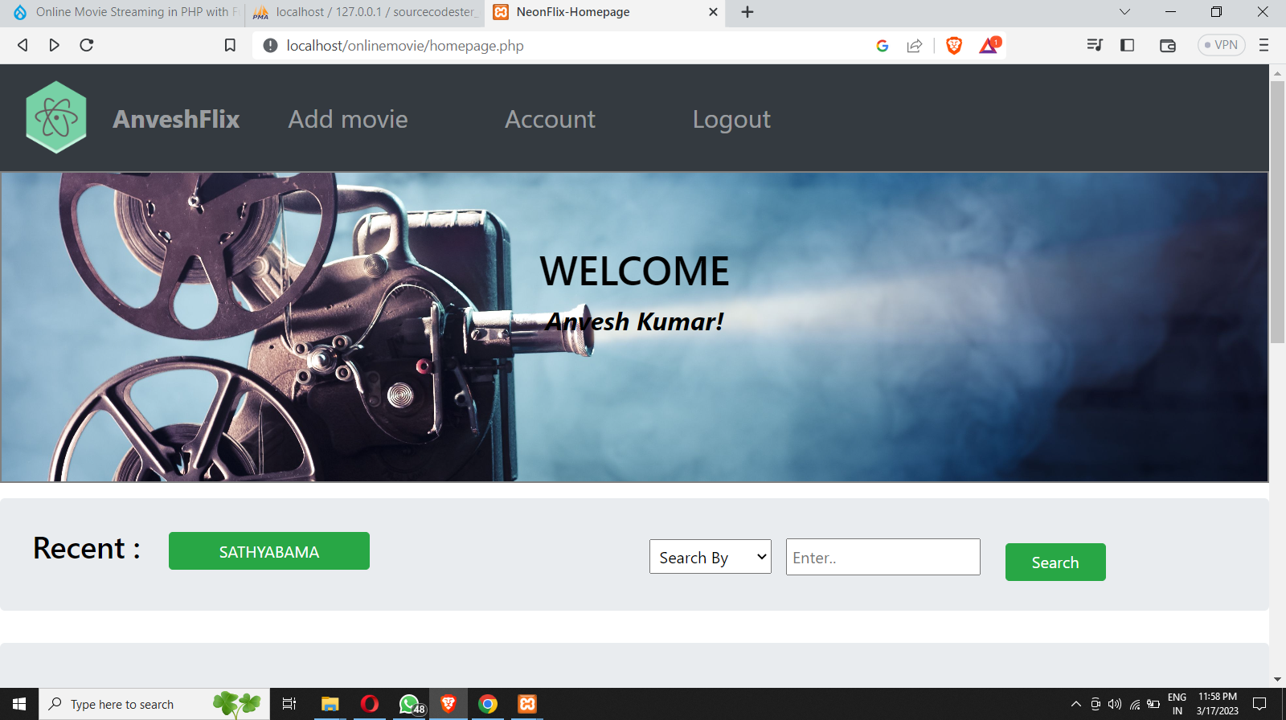
Snapshots of the model
HOME PAGE:

Slide 16
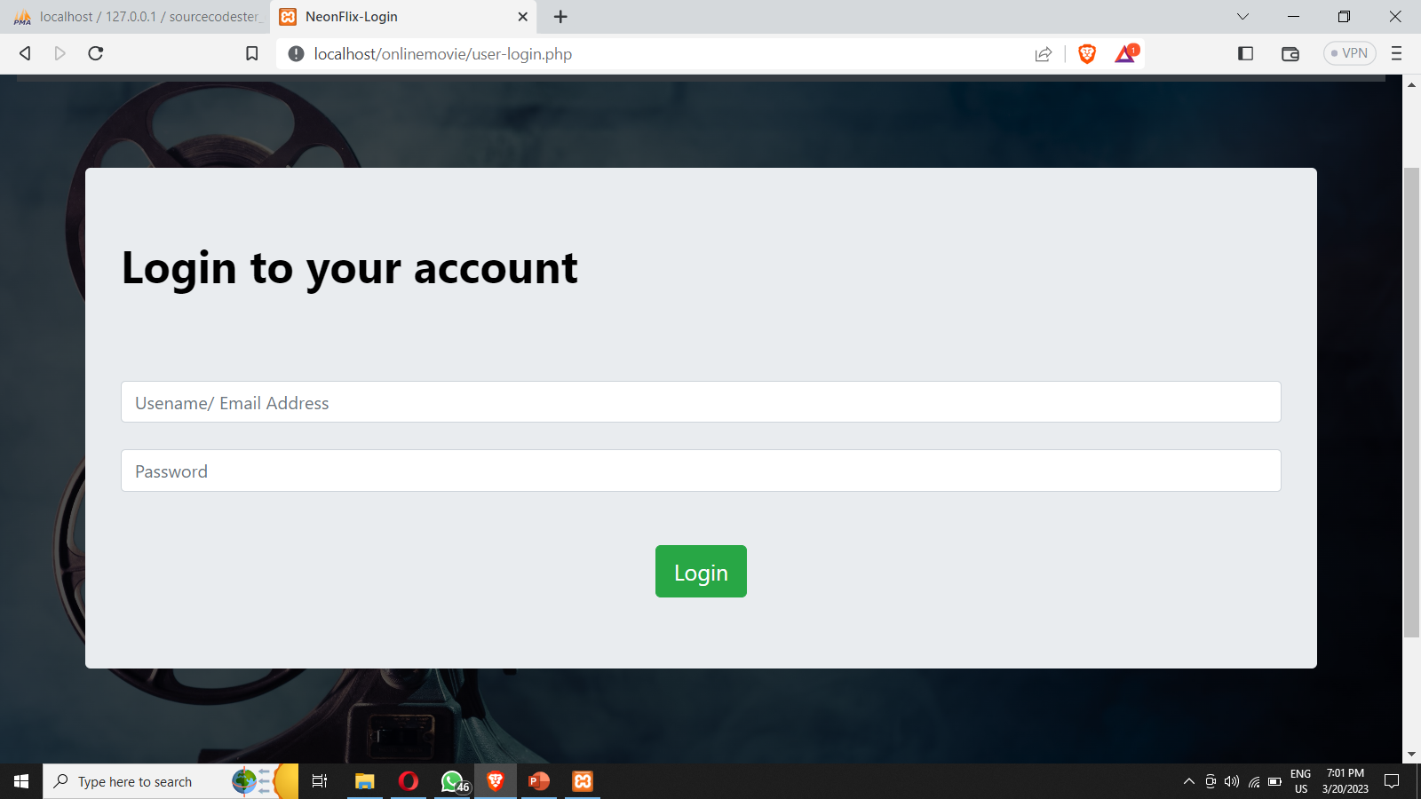
Snapshots of the model
LOGIN PAGE:

Slide 17
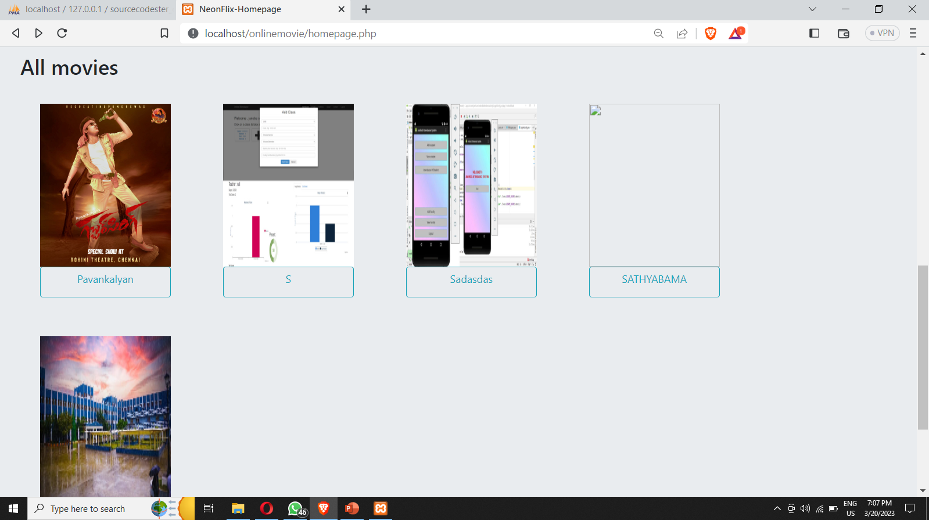
Snapshots of the model

Slide 18
Performance Analysis
STRENGTH:
High-Quality Viewing Experience
Scalability, Accessibility
Data Analytics
Low monthly cost for unlimited at 7.99 per month
WEAKNESS:
Take debt to fund extreme content licensing.
Technical errors
User accessibility
Not available in Europe and other countries due to legal issues.
Infrastructure Costs, Infrastructure Costs

Slide 19
Conclusion
Technology have been evolving day by day. Every day there is new products are launched. So, we have decided to change our previous traditional system with a fully functionality which include new features that are not available in existing system. We use different methods and software developing tools for developing our system. It will be useful for any college and university students who want to use and know new technology and it will be convenient for them. They will get rid from compulsory attending the classes because sometimes students may busy in urgent work and can’t reach in the class on time.

Slide 20
Conclusion
Video technology is always changing to keep up with consumer demand and individual and organizational inventiveness. Today, we're seeing the rise of new virtual (video-based) social interactions, quicker content delivery procedures, and services that provide the highest-quality content to any device with almost any bandwidth. This blog post served as an introduction to video streaming technologies

Slide 21
References
Anonymous. (2017, 7 4). Retrieved from Wikipedia: https://en.wikipedia.org/wiki/Online_lecture
TechSmith. (2019, 8 5). Retrieved from Techsmith.com: https://www.techsmith.com/blog/lecture-capture/
Software Engineering a Practitioner's Approach - Roger S Pressman – Fifth Edition.

Slide 22


